Slide 1

Technology: Java
Photography Website

Slide 2
INDEX
Abstract
Introduction
Literature review
Existing Method
Drawbacks
Proposed method
Advantages
Implementation
Architecture
Modules
UML diagrams
Results
Conclusion
References

Slide 3
ABSTRACT
The amazing developments in science and technology have raised the bar for human living standards. Without these improvements, the entire planet will be physically congested. Compared to other projects now in existence, this project is innovative in that it simplifies the process of booking photographer. Java has been used to implement this project. The project's goal is to create an application software to lessen the human labour involved in keeping track of the photographers and booking photographers based on whether they are individual (house) , outside the home or different places. It shows photographer information. Here user can book photographers by through this project. Users need not to go directly to the photographers, here we are added the feature of admin like adding all the photographers, user can check photographers directly he/she can get access through the details.
Keywords: Shadowgraphy, Photographer, Booking history, Userbooking, Type of photographs(Portrait, Fashion, Natural, Sports etc )

Slide 4
INTRODUCTION
It is a new concept booking photographers using Java, where the other existing methods of booking photographers use Java, PHP, Python, C#, MS Access server. This system is made to keep the records about the bills of the customers. The administrator can manage all the accounts; the registered users like individual customers, commercial customers can only manage their own accounts and they cannot see any details of other customers. This system helps in maintaining the photographers. There are four modules namely Registration, Login, Admin and Photographers screen.
SOFTWARE DESCRIPTION
A. JAVA
Java is one of the computer languages which is purely object oriented. It has having many features of C++. This language can be used for doing web-based programs. Java supports
• Data abstraction and encapsulation.
• Inheritance.

Slide 5
• Polymorphism.
• Dynamic binding.
B. BENEFITS AND APPLICATION OF OOPS
Since oops supports inheritance and polymorphism, it eliminates redundant codes and extend the use of existing classes. Therefore, we can build the programs on a classic working model. This ensures high productivity. Data hiding helps the programmer to build secure applications. It is easy to have multiple objects to co-exist and better possibility of upgradation. Software complexity can easily manage. Following are the features of Java,
• Compiled and interpreted.
• Platform independent and portable.
• Object oriented.
• Robust and secure.

Slide 6
Familiar, simple and small.
Distributed.
Multithreaded and interactive.
High performance.
Dynamic and extensible.
Java compiler compiles and interprets the source code and generates machine code that can be directly run by the Java Runtime Environment. Since this code is platform independent it can be ported to any system we use or work on. This features enables the programmer to develop browser programs. Actually, java provides unlimited number of cacheable applets and applications. Each and every thing in java is represented in objects. All the data and objects are resets inside the objects and classes. Java provides many safeguards, it has strict run time and compile time checking. Java provides safeguards to code written it is designed as a garbage collected language relieving the programmers virtually all memory management problems.

Slide 7
LITERATURE REVIEW
S. No | Journal Type with year | Authors | Title | Outcomes
1 | SIIT, 1973 | Spencer | The Focal Dictionary of Photographic Technologies | Online Photoshoot Booking Service is a bunch of benefits from the various point of views. As this online application enables the end user to register to the system online.
2 | IJSRP, 1945 | Eder | History of Photography | Photo Phactory is a website designed primarily for use in the Photography industry. This system will allow all categories of Photographers to increase scope of business by promoting themselves
3 | ISSN, 2010 | E. Moni Silviya, K. Meena Vinodhini | Museums Association of Saskatchewan | This technology reduced the man power, reading collection time, theft of electricity also avoids late book photographer.
4 | Journal, 1839 | Vossische Zeitung | Photography | With an electronic image sensor, this produces an electrical charge at each pixel, which is electronically processed and stored in a digital image file for subsequent display or processing.

Slide 8
EXISTING METHOD
In the existing system process of booking photography session was done manually by phone calls or drop by at their place. It is hard to track the availability of the photographer and to manage all the bookings made by customers. They are reluctant to change their current process since it will be an extra effort. The Photography border cannot invest a huge amount of money for a new solution. However, the customers face immense problems with the current procedure of using this manual process to booking photographer.
Dis advantages:
Required Manual efforts
Requires more time

Slide 9
PROPOSED METHOD
To overcome the problem with an existing system, we are implementing an application called online photography website system using java. In the proposed system all the data is maintained in the database which is safe and easy to retrieve. Users can book the photographer anytime and anywhere. User can know the location of the photo shoot.
Advantages:
Manual process not required
Requires less time

Slide 10
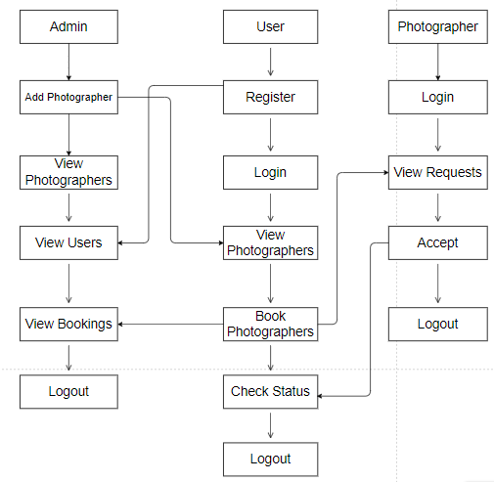
PROPOSED METHOD
Block diagram of proposed method

Slide 11
IMPLEMENTATION
Install the required packages
Defining the problem association.
Runs admin and user modules.

Slide 12
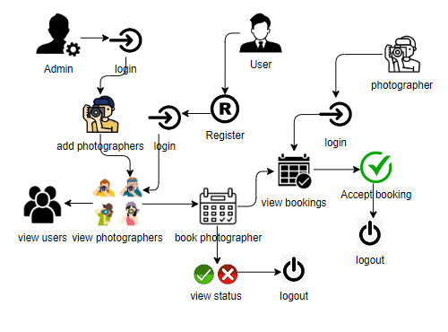
ARCHITECTURE
Architecture diagram of proposed method

Slide 13
SYSTEM REQUIREMENTS
SOFTWARE AND HARDWARE REQUIREMENTS:
Operating system : Windows 7 or 7+
Ram : 8 GB
Hard disc or SSD : More than 500 GB
Processor : Intel 3rd generation or high with 8 GB Ram
Software’s : Java 8 or high version, Eclipse.

Slide 14
MODULES
This project contains four modules as mentioned in below are:
Admin:
Admin must login with valid default credentials, Admin will add the photographers with their personals details later on admin view all the photographers, all registered users and all bookings by user.
User:
User can register with their own details and login with required details and user can view all photographers were admin added photographers. User can book photographer with their choice and he can check their status whether photographer accepted or not.

Slide 15
MODULES
3. Photographer:
Photographer can login with their details which are added by admin. Photographer can view all requests which are sent by particular user and can accept that request.

Slide 16
UML DIAGRAMS
Uml stands for unified modeling language. Uml is a standardized general-purpose modeling language in the field of object-oriented software engineering. The standard is managed, and was created by, the object management group.
The goal is for uml to become a common language for creating models of object oriented computer software. In its current form uml is comprised of two major components: a meta-model and a notation. In the future, some form of method or process may also be added to; or associated with, uml.
The unified modeling language is a standard language for specifying, visualization, constructing and documenting the artifacts of software system, as well as for business modeling and other non-software systems.
The uml represents a collection of best engineering practices that have proven successful in the modeling of large and complex systems.

Slide 17
The uml is a very important part of developing objects oriented software and the software development process. The uml uses mostly graphical notations to express the design of software projects.
GOALS:
The Primary goals in the design of the UML are as follows:
Provide users a ready-to-use, expressive visual modeling Language so that they can develop and exchange meaningful models.
Provide extendibility and specialization mechanisms to extend the core concepts.
Be independent of particular programming languages and development process.
Provide a formal basis for understanding the modeling language.
Encourage the growth of OO tools market.
Support higher level development concepts such as collaborations, frameworks, patterns and components.
Integrate best practices.

Slide 18
Use case diagram:
A use case diagram in the unified modeling language (uml) is a type of behavioral diagram defined by and created from a use-case analysis. Its purpose is to present a graphical overview of the functionality provided by a system in terms of actors, their goals (represented as use cases), and any dependencies between those use cases. The main purpose of a use case diagram is to show what system functions are performed for which actor. Roles of the actors in the system can be depicted.

Slide 19
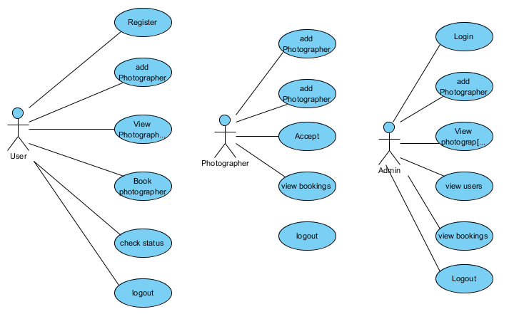

Slide 20
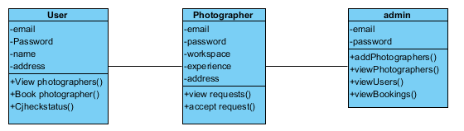
Class diagram:
In software engineering, a class diagram in the unified modeling language (uml) is a type of static structure diagram that describes the structure of a system by showing the system's classes, their attributes, operations (or methods), and the relationships among the classes. It explains which class contains information.

Slide 21
Sequence diagram:
A sequence diagram in unified modeling language (uml) is a kind of interaction diagram that shows how processes operate with one another and in what order. It is a construct of a message sequence chart. Sequence diagrams are sometimes called event diagrams, event scenarios, and timing diagrams.

Slide 22
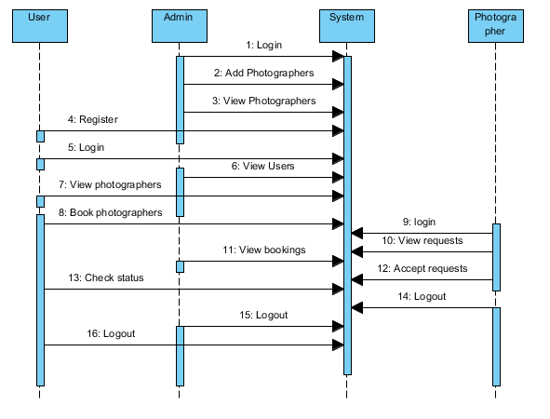

Slide 23
Collaboration diagram:
In collaboration diagram the method call sequence is indicated by some numbering technique as shown below. The number indicates how the methods are called one after another. We have taken the same order management system to describe the collaboration diagram. The method calls are similar to that of a sequence diagram. But the difference is that the sequence diagram does not describe the object organization whereas the collaboration diagram shows the object organization.

Slide 24
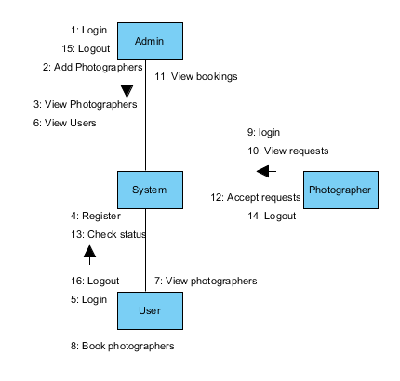

Slide 25
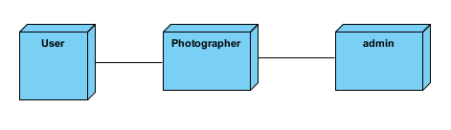
Deployment diagram:
Deployment diagram represents the deployment view of a system. It is related to the component diagram. Because the components are deployed using the deployment diagrams. A deployment diagram consists of nodes. Nodes are nothing but physical hard ware’s used to deploy the application.

Slide 26
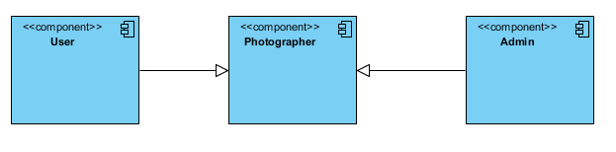
Component diagram:
Component diagrams are used to describe the physical artifacts of a system. This artifact includes files, executable, libraries etc. So the purpose of this diagram is different, component diagrams are used during the implementation phase of an application. But it is prepared well in advance to visualize the implementation details. Initially the system is designed using different uml diagrams and then when the artifacts are ready component diagrams are used to get an idea of the implementation.

Slide 27
Activity diagram:
Activity diagrams are graphical representations of workflows of stepwise activities and actions with support for choice, iteration and concurrency. In the unified modeling language, activity diagrams can be used to describe the business and operational step-by-step workflows of components in a system. An activity diagram shows the overall flow of control.

Slide 28
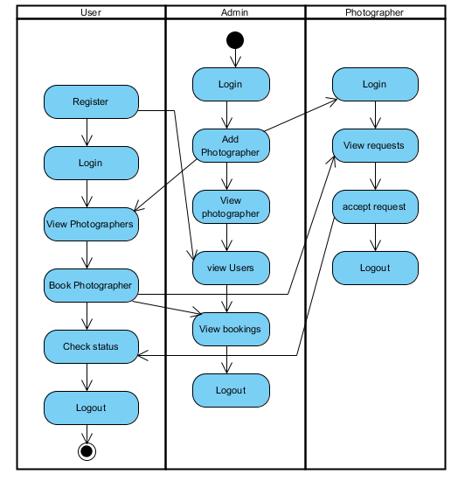

Slide 29
ER Diagram:
An Entity–relationship model (ER model) describes the structure of a database with the help of a diagram, which is known as Entity Relationship Diagram (ER Diagram). An ER model is a design or blueprint of a database that can later be implemented as a database. The main components of E-R model are: entity set and relationship set.
An ER diagram shows the relationship among entity sets. An entity set is a group of similar entities and these entities can have attributes. In terms of DBMS, an entity is a table or attribute of a table in database, so by showing relationship among tables and their attributes, ER diagram shows the complete logical structure of a database. Let’s have a look at a simple ER diagram to understand this concept.

Slide 30
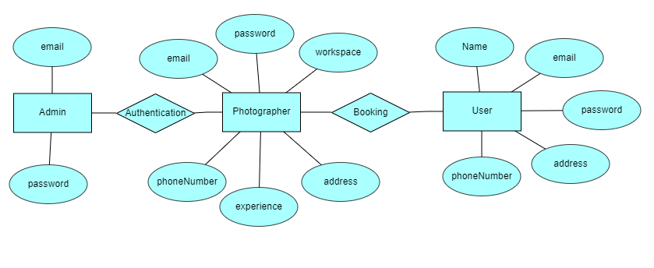

Slide 31
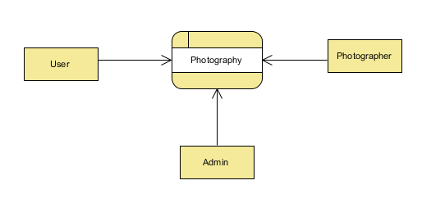
DFD Diagram:
A Data Flow Diagram (DFD) is a traditional way to visualize the information flows within a system. A neat and clear DFD can depict a good amount of the system requirements graphically. It can be manual, automated, or a combination of both. It shows how information enters and leaves the system, what changes the information and where information is stored. The purpose of a DFD is to show the scope and boundaries of a system as a whole. It may be used as a communications tool between a systems analyst and any person who plays a part in the system that acts as the starting point for redesigning a system.

Slide 32
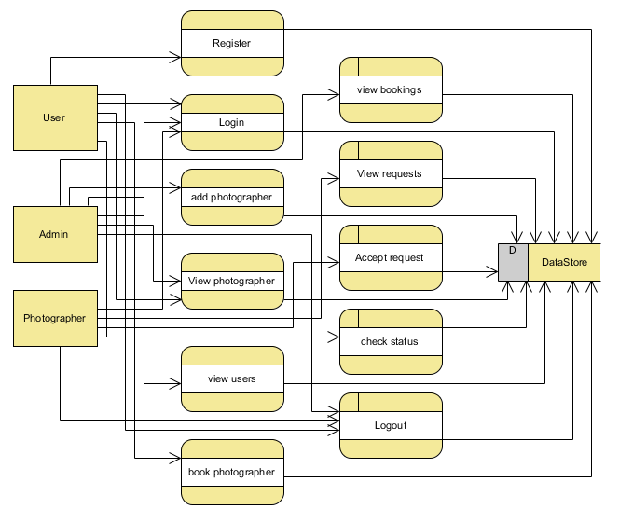

Slide 33
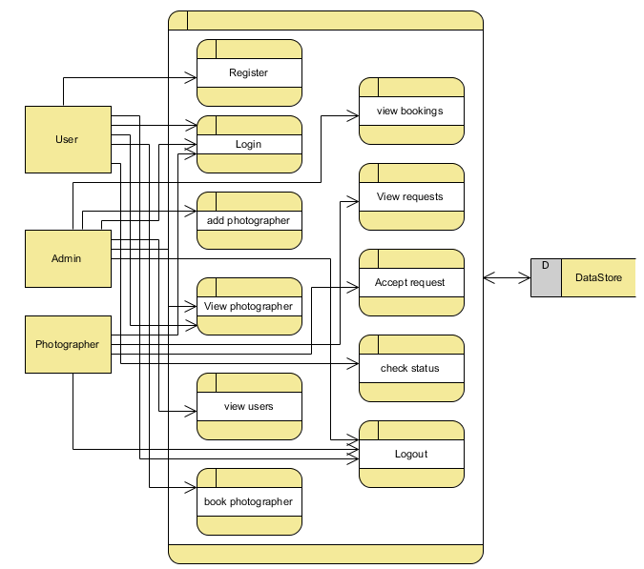

Slide 34
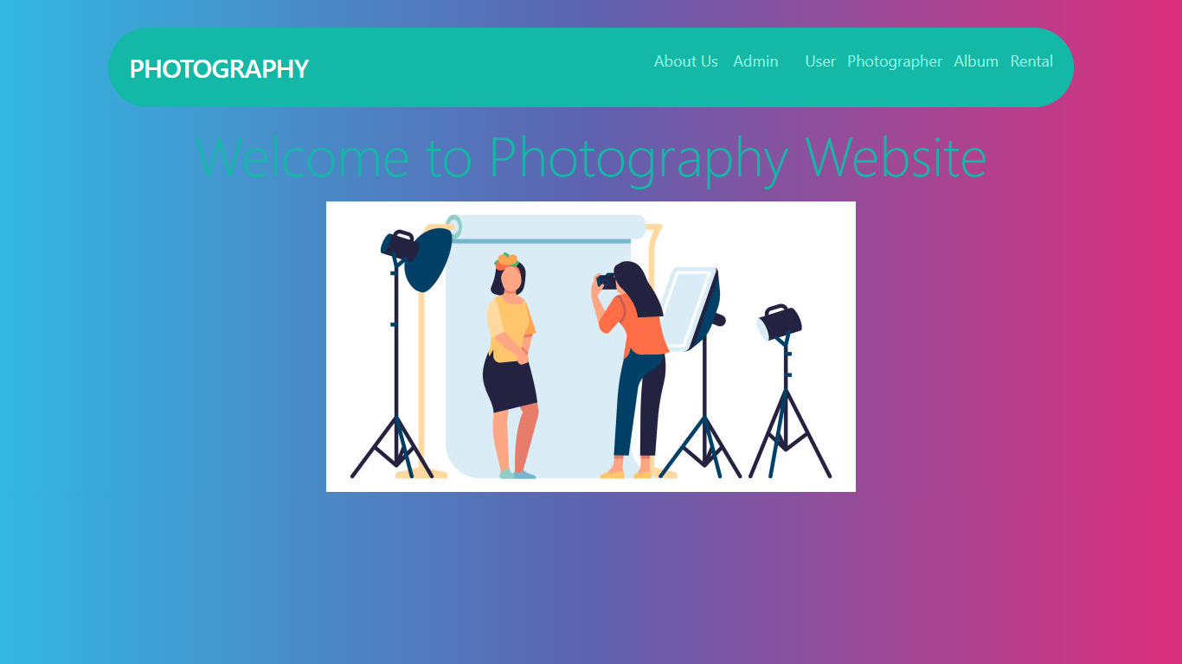
RESULTS
Home : This is the home page our project.

Slide 35
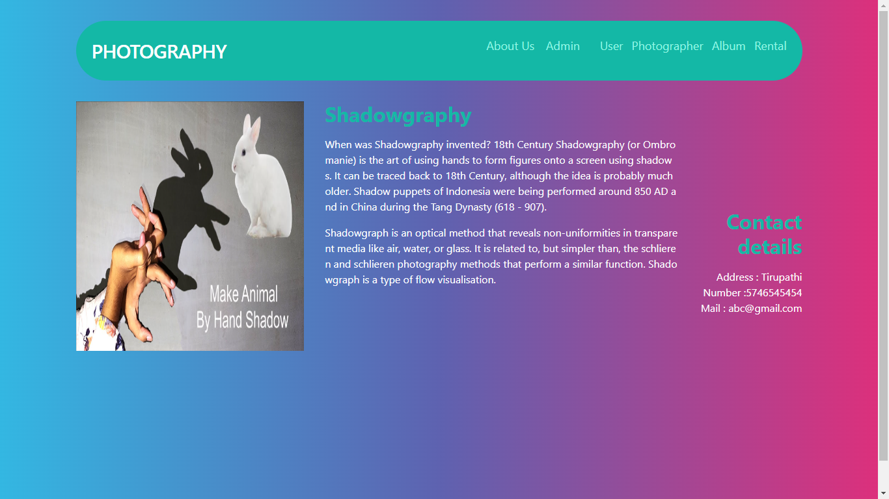
About Us: This is the page inside about us about shadowgraphy.

Slide 36
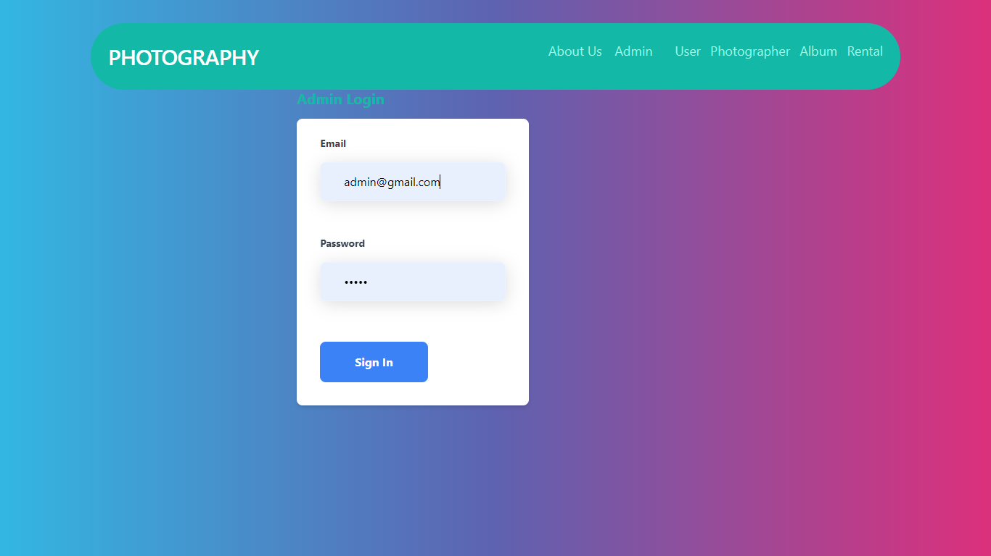
Admin Login: This is admin Login page, login with default credentials like admin@gmail.com and admin.

Slide 37
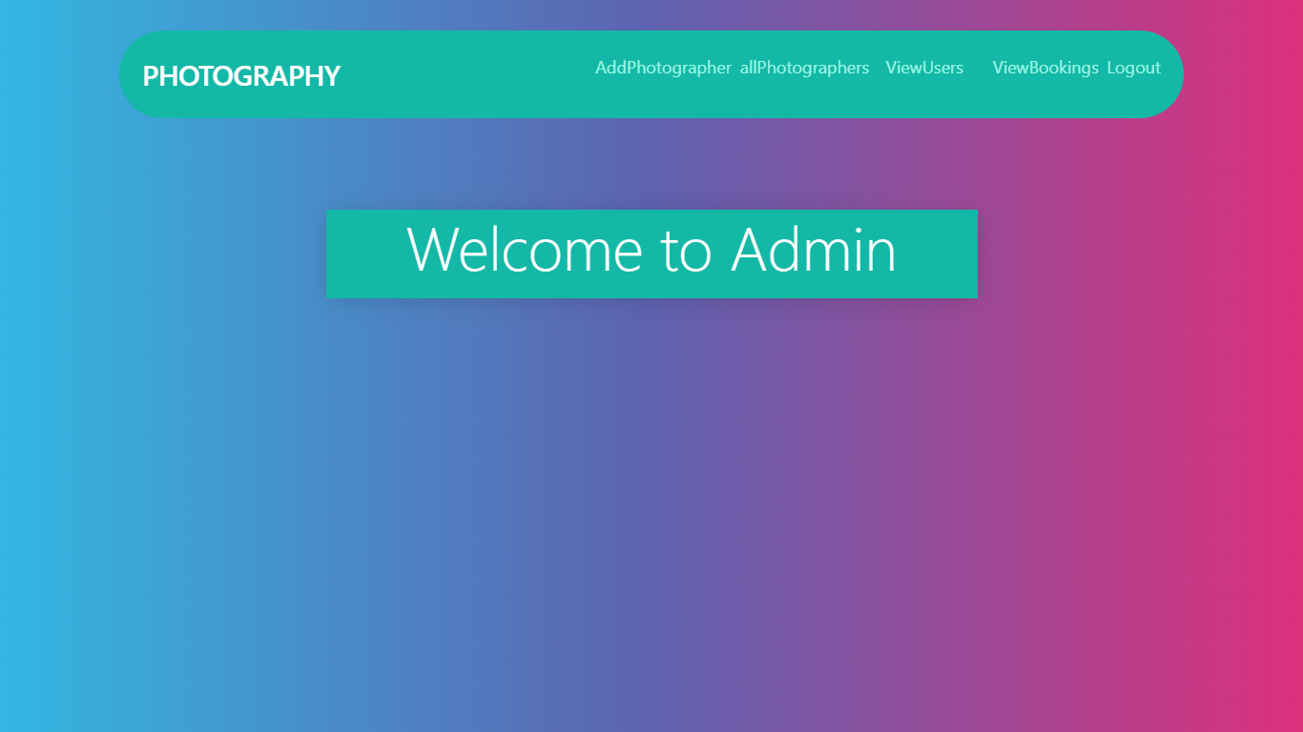
Admin Home: This is admin home page.

Slide 38
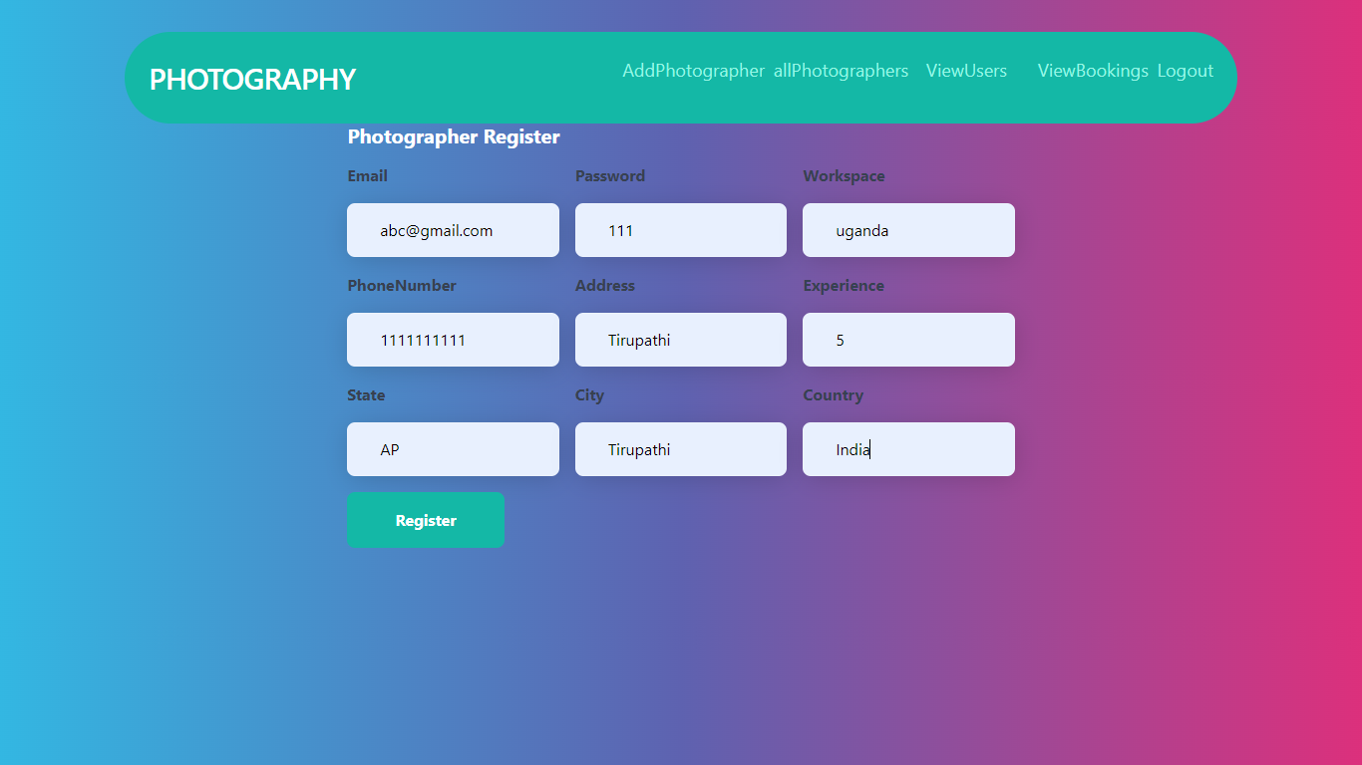
Add Photographer: Here admin can add photographers

Slide 39
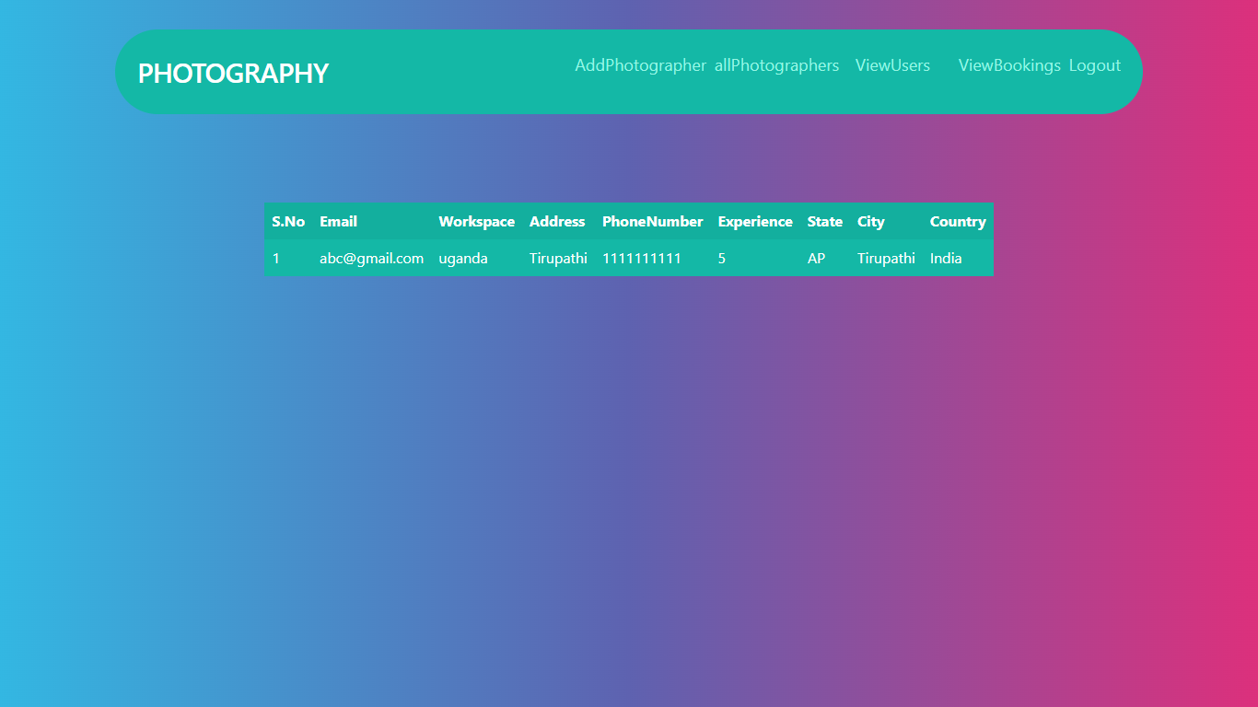
View Photographers: Here admin view all Photographers which are already added.

Slide 40
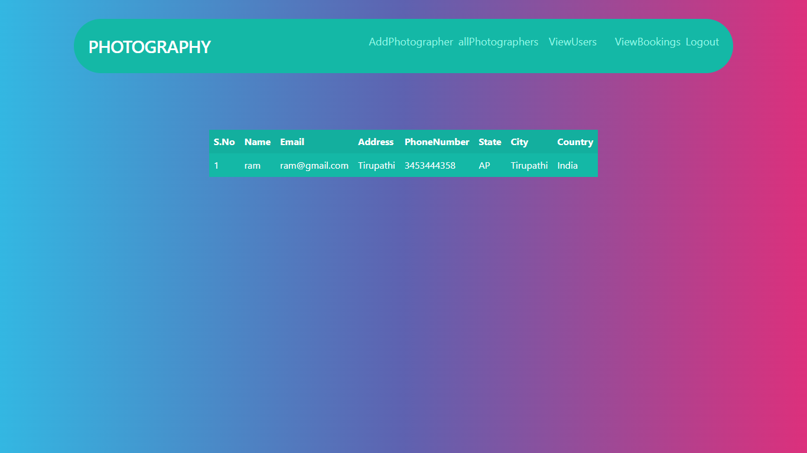
View Users: Here admin view all users who are registered.

Slide 41
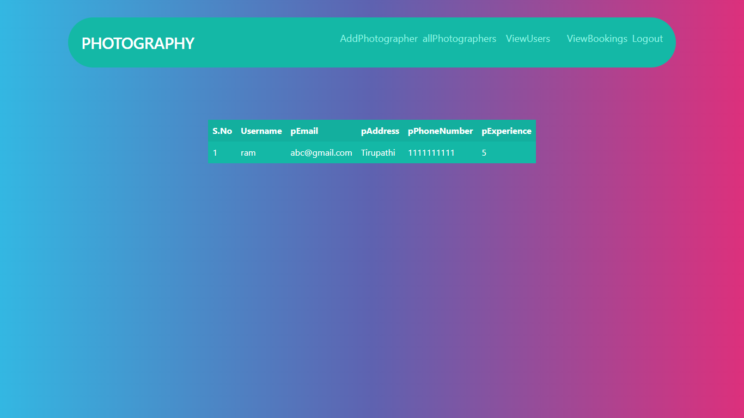
View Bookings: Here admin view all bookings by the users.

Slide 42

User Login: Here user can login with their required details.

Slide 43
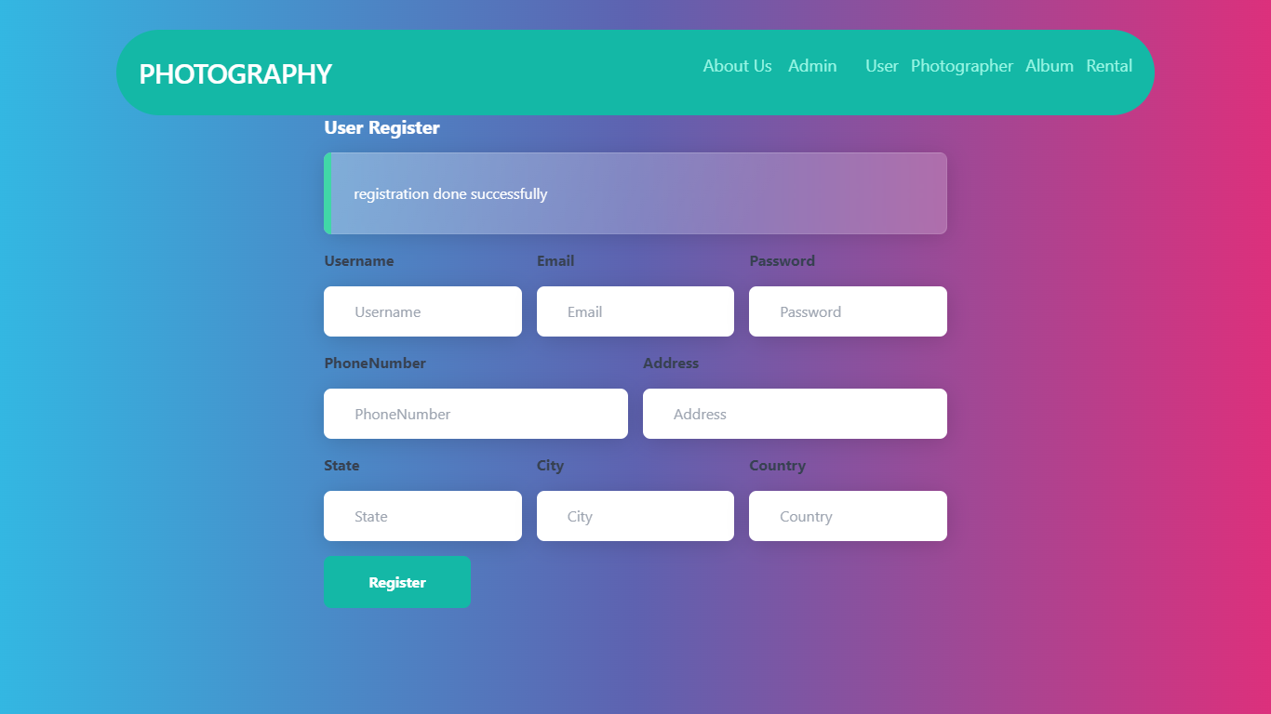
User Register: If the user login first time then must be register with these page.

Slide 44
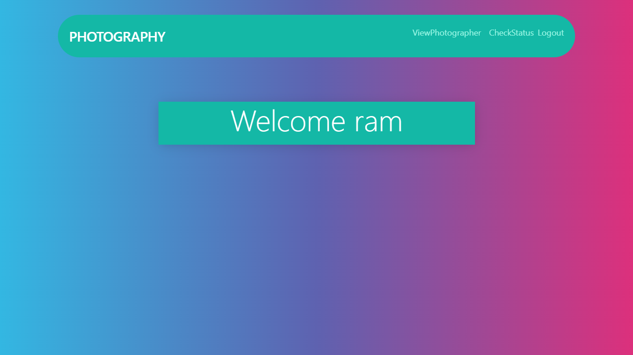
User Home: This is the user home page.

Slide 45
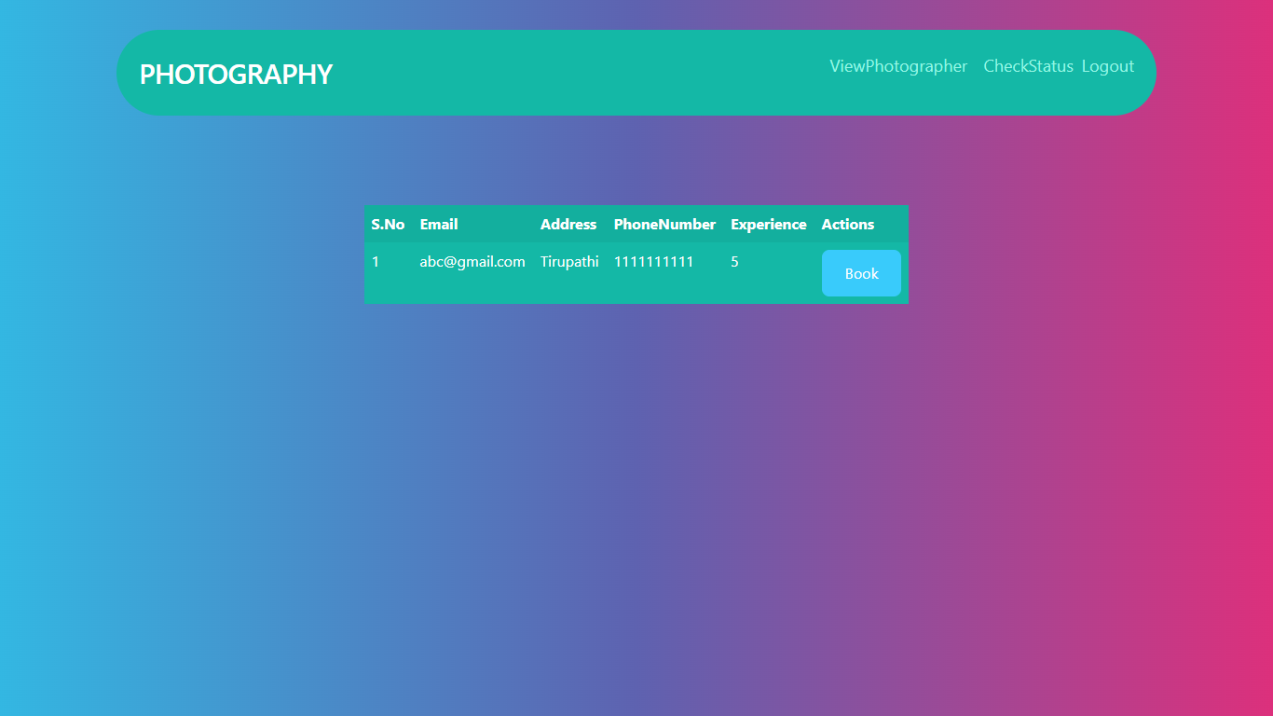
User booking page: After login user can view photographers and book particular photographer.

Slide 46
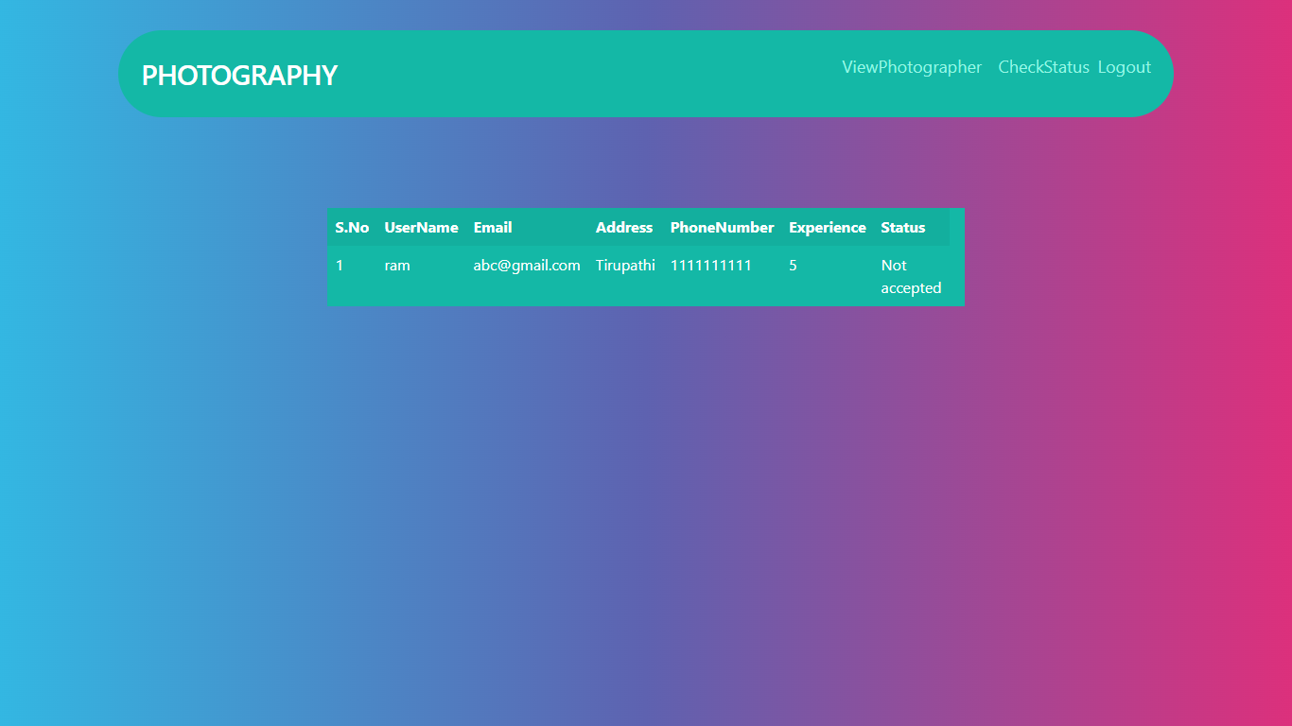
Check Status: User can check the status its accepted or not by the photographer.

Slide 47

Photographer login: Here photographer login with required credentials which are added by the admin.

Slide 48

Photographer Home: This is the photographer home page.

Slide 49
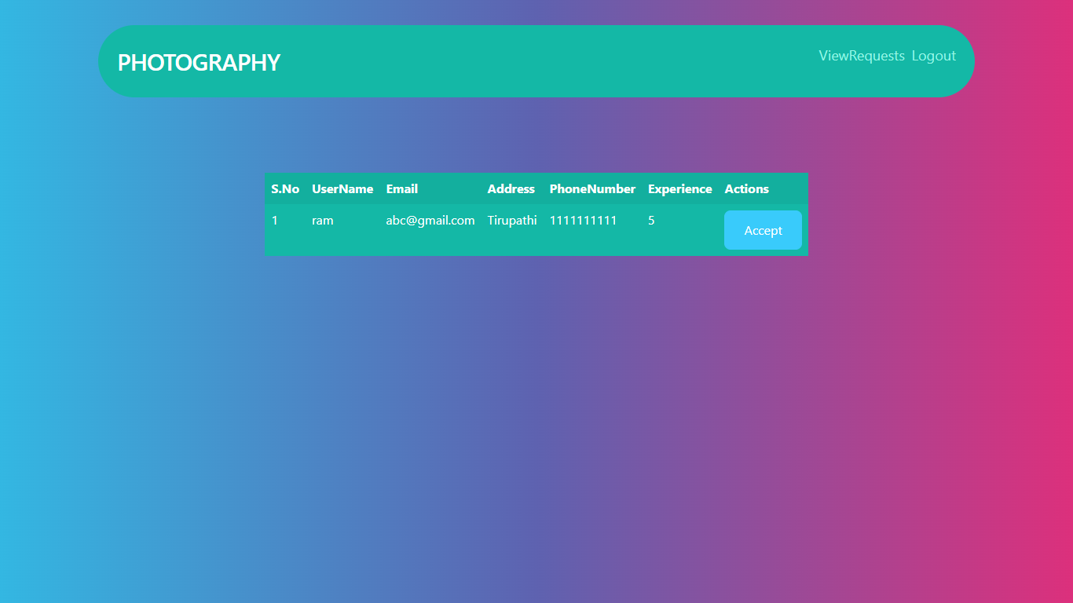
View Requests and Accept: Here photographer can view all the requests which are booked by the user.

Slide 50
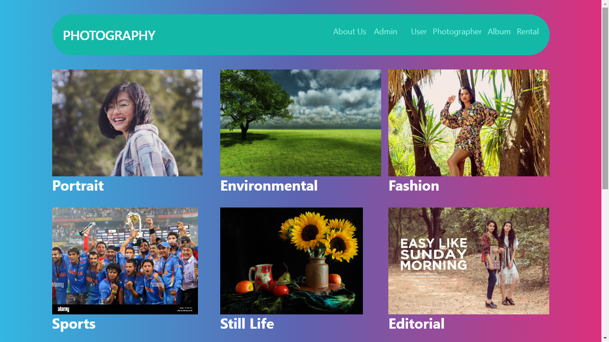
Album: This is the album page here we can see different types of photographs.

Slide 51
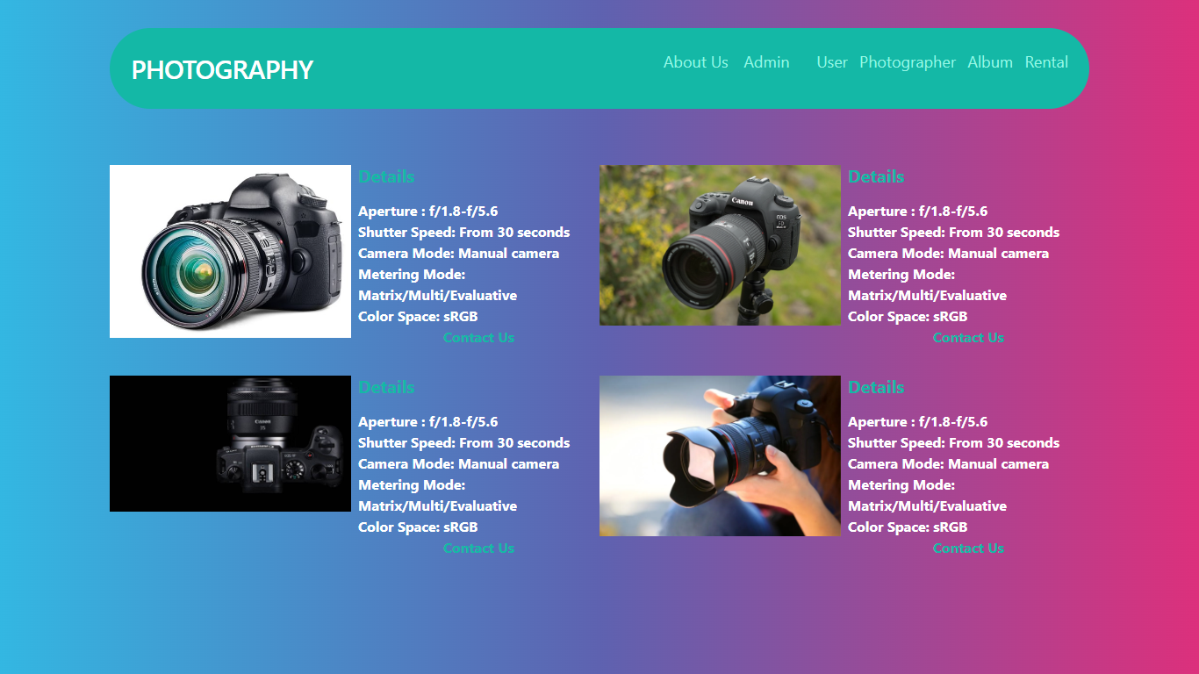
Rentals: This is rentals page here we can see some rentals cameras.

Slide 52
CONCLUSION
In this project we have successfully created a user friendly web application called Photography Website which is useful to the users to book photographers via onlne. The project's goal is to create an application software to lessen the human labour involved. Here Admin can add all the photographers and also view all photographers , users, bookings. User can register and login with their own details. Here user can book photographers by through this project. Users need not to go directly to the photographers, here we are added the feature of admin like adding all the photographers, user can check photographers directly he/she can get access through the details.

Slide 53
REFERENCES
1) Spencer, D A (1973). The Focal Dictionary of Photographic Technologies. Focal Press. p. 454. ISBN 978-0133227192.
2. Eder, J.M. (1945) [1932]. History of Photography, 4th. edition [Geschichte der Photographie]. New York: Dover Publications, Inc. pp. 258–59. ISBN 978-0486235868.
3. Nacional de Antropología e Historia. ISBN 978- 9680300204
4. "Photography". Vossische Zeitung. 25 February 1839.

